Slide 1
Programming with OpenGL Part 3: Three Dimensions

Slide 2
Objectives
Develop a more sophisticated three-dimensional example
Sierpinski gasket: a fractal
Introduce hidden-surface removal

Slide 3
Three-dimensional Applications
In OpenGL, 2D applications are a special case of 3D graphics
Going from 2D to 3D
Use glVertex3f()
Have to worry about the order in which polygons are drawn or use hidden-surface removal

Slide 4
Sierpinski Gasket (2D)
Start with a triangle
Connect bisectors of sides and remove central triangle
Repeat

Slide 5
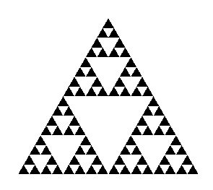
Example
Five subdivisions

Slide 6
The gasket as a fractal
Consider the filled area (black) and the perimeter (the length of all the lines around the filled triangles)
As we continue subdividing
the area goes to zero
but the perimeter goes to infinity
This is not an ordinary geometric object
It is neither two- nor three-dimensional
It is a fractal (fractional dimension) object

Slide 7
Gasket2d code
//---------------------------------------
// Program: gasket2d.c
// Purpose: To display 2D Sierpenski gasket
// Author: John Gauch
// Date: September 2008
//---------------------------------------
#include <math.h>
#include <stdio.h>
#include <stdlib.h>
#include <GL/glut.h>
//---------------------------------------
// Init function for OpenGL
//---------------------------------------
void init()
{
glClearColor(0.0, 0.0, 0.0, 1.0);
glMatrixMode(GL_PROJECTION);
glLoadIdentity();
glOrtho(-1.0, 1.0, -1.0, 1.0, -1.0, 1.0);
}

Slide 8
Gasket2d code
Angel: Interactive Computer Graphics 5E © Addison-Wesley 2009
8
//---------------------------------------
// Function to draw 2D Sierpinski gasket
//---------------------------------------
void gasket(int n,
float ax, float ay,
float bx, float by,
float cx, float cy)
{
// Draw single trangle
if (n <= 0)
{
glVertex2f(ax, ay);
glVertex2f(bx, by);
glVertex2f(cx, cy);
}

Slide 9
Gasket2d code
Angel: Interactive Computer Graphics 5E © Addison-Wesley 2009
9
// Handle recursive case
else
{
float dx = (ax+bx)/2;
float dy = (ay+by)/2;
float ex = (bx+cx)/2;
float ey = (by+cy)/2;
float fx = (cx+ax)/2;
float fy = (cy+ay)/2;
gasket(n-1, ax, ay, dx, dy, fx, fy);
gasket(n-1, bx, by, ex, ey, dx, dy);
gasket(n-1, cx, cy, fx, fy, ex, ey);
}
}

Slide 10
Gasket2d code
Angel: Interactive Computer Graphics 5E © Addison-Wesley 2009
10
//---------------------------------------
// Draw callback for OpenGL
//---------------------------------------
void draw()
{
glClear(GL_COLOR_BUFFER_BIT);
glBegin(GL_TRIANGLES);
glColor3f(1.0, 0.0, 0.0);
gasket(4, 0,0.5, -0.5,-0.5, 0.5,-0.5);
glEnd();
glFlush();
}

Slide 11
Gasket2d code
Angel: Interactive Computer Graphics 5E © Addison-Wesley 2009
11
//---------------------------------------
// Main program
//---------------------------------------
int main(int argc, char *argv[])
{
glutInit(&argc, argv);
glutInitWindowSize(500, 500);
glutInitWindowPosition(250, 250);
glutInitDisplayMode(GLUT_RGB | GLUT_SINGLE);
glutCreateWindow("Gasket2D");
glutDisplayFunc(draw);
init();
glutMainLoop();
return 0;
}

Slide 12
Efficiency Note
By having the glBegin and glEnd in the display callback rather than in the function triangle and using GL_TRIANGLES rather than GL_POLYGON in glBegin, we call glBegin and glEnd only once for the entire gasket rather than once for each triangle

Slide 13
3D Gasket
We can subdivide each of the four faces
Appears as if we remove a solid tetrahedron from the center leaving four smaller tetrahedra

Slide 14
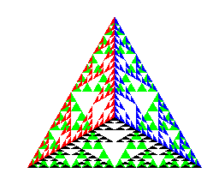
Example
after 5 iterations

Slide 15
Gasket3d code
Angel: Interactive Computer Graphics 5E © Addison-Wesley 2009
15
//---------------------------------------
// Program: gasket3d.c
// Purpose: To display 3D Sierpenski gasket
// Author: John Gauch
// Date: September 2008
//---------------------------------------
#include <math.h>
#include <stdio.h>
#include <stdlib.h>
#include <GL/glut.h>
//---------------------------------------
// Init function for OpenGL
//---------------------------------------
void init()
{
glClearColor(0.0, 0.0, 0.0, 1.0);
glMatrixMode(GL_PROJECTION);
glLoadIdentity();
glOrtho(-1.0, 1.0, -1.0, 1.0, -1.0, 1.0);
glMatrixMode(GL_MODELVIEW);
glEnable(GL_DEPTH_TEST);
}

Slide 16
Gasket3d code
Angel: Interactive Computer Graphics 5E © Addison-Wesley 2009
16
//---------------------------------------
// Function to draw 3D Sierpinski gasket
//---------------------------------------
void gasket(int n,
float ax, float ay, float az,
float bx, float by, float bz,
float cx, float cy, float cz)
{
// Draw single trangle
if (n <= 0)
{
glVertex3f(ax, ay, az);
glVertex3f(bx, by, bz);
glVertex3f(cx, cy, cz);
}

Slide 17
Gasket3d code
Angel: Interactive Computer Graphics 5E © Addison-Wesley 2009
17
// Handle recursive case
else
{
float dx = (ax+bx)/2;
float dy = (ay+by)/2;
float dz = (az+bz)/2;
float ex = (bx+cx)/2;
float ey = (by+cy)/2;
float ez = (bz+cz)/2;
float fx = (cx+ax)/2;
float fy = (cy+ay)/2;
float fz = (cz+az)/2;
gasket(n-1, ax, ay, az, dx, dy, dz, fx, fy, fz);
gasket(n-1, bx, by, bz, ex, ey, ez, dx, dy, dz);
gasket(n-1, cx, cy, cz, fx, fy, fz, ex, ey, ez);
}
}

Slide 18
Gasket3d code
Angel: Interactive Computer Graphics 5E © Addison-Wesley 2009
18
//---------------------------------------
// Draw callback for OpenGL
//---------------------------------------
void draw()
{
float ax = 0.0;
float ay = 0.5;
float az = -0.5;
float bx = -0.43;
float by = -0.25;
float bz = -0.5;
float cx = 0.43;
float cy = -0.25;
float cz = -0.5;
float dx = 0.0;
float dy = 0.0;
float dz = 0.0;

Slide 19
Gasket3d code
Angel: Interactive Computer Graphics 5E © Addison-Wesley 2009
19
glClear(GL_COLOR_BUFFER_BIT | GL_DEPTH_BUFFER_BIT);
glBegin(GL_TRIANGLES);
glColor3f(0.5, 0.5, 0.5);
gasket(3, ax, ay, az, bx, by, bz, cx, cy, cz);
glColor3f(1.0, 0.0, 0.0);
gasket(3, dx, dy, dz, ax, ay, az, bx, by, bz);
glColor3f(0.0, 1.0, 0.0);
gasket(3, dx, dy, dz, bx, by, bz, cx, cy, cz);
glColor3f(0.0, 0.0, 1.0);
gasket(3, dx, dy, dz, cx, cy, cz, ax, ay, az);
glEnd();
glFlush();
}

Slide 20
Gasket3d code
Angel: Interactive Computer Graphics 5E © Addison-Wesley 2009
20
//---------------------------------------
// Main program
//---------------------------------------
int main(int argc, char *argv[])
{
glutInit(&argc, argv);
glutInitWindowSize(500, 500);
glutInitWindowPosition(250, 250);
glutInitDisplayMode(GLUT_RGB | GLUT_SINGLE | GLUT_DEPTH);
glutCreateWindow("Gasket3D");
glutDisplayFunc(draw);
init();
glutMainLoop();
return 0;
}

Slide 21
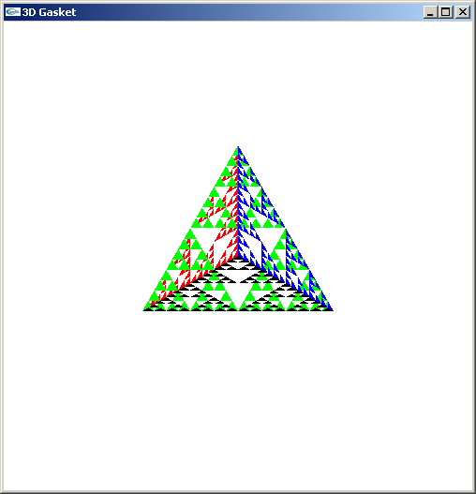
Almost Correct
Because the triangles are drawn in the order they are defined in the program, the front triangles are not always rendered in front of triangles behind them
get this
want this

Slide 22
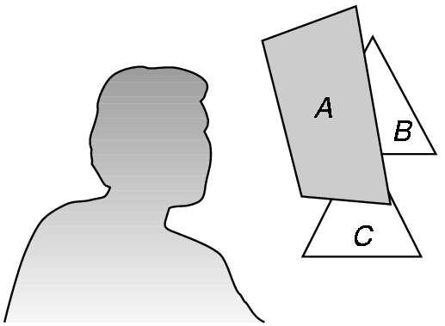
Hidden-Surface Removal
We want to see only those surfaces in front of other surfaces
OpenGL uses a hidden-surface method called the z-buffer algorithm that saves depth information as objects are rendered so that only the front objects appear in the image

Slide 23
Using the z-buffer algorithm
The algorithm uses an extra buffer, the z-buffer, to store depth information as geometry travels down the pipeline
It must be
Requested in main.c
glutInitDisplayMode
(GLUT_SINGLE | GLUT_RGB | GLUT_DEPTH)
Enabled in init.c
glEnable(GL_DEPTH_TEST)
Cleared in the display callback
glClear(GL_COLOR_BUFFER_BIT |
GL_DEPTH_BUFFER_BIT)

Slide 24
Surface vs Volume Subdvision
In our example, we divided the surface of each face
We could also divide the volume using the same midpoints
The midpoints define four smaller tetrahedrons, one for each vertex
Keeping only these tetrahedrons removes a volume in the middle

Slide 25
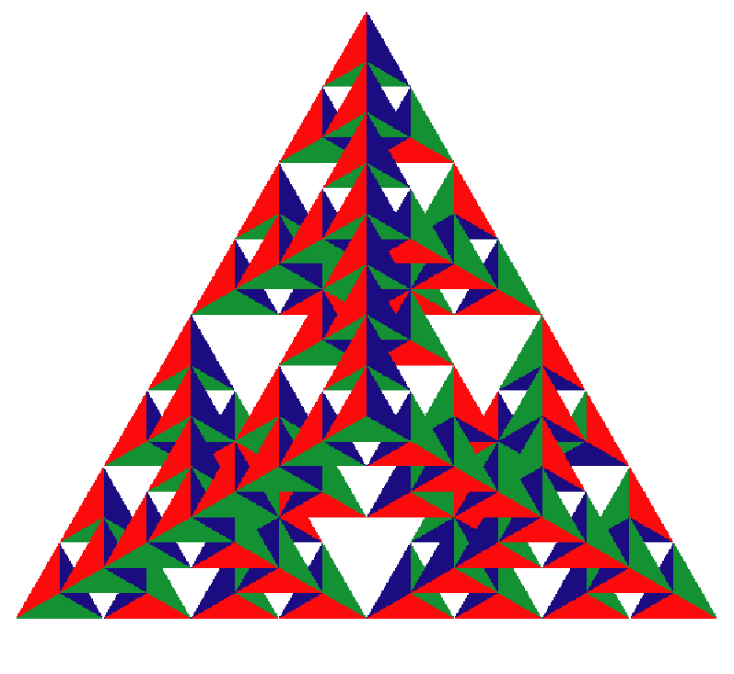
Volume Subdivision

